Slide 1
TOPIC: ROTATIONAL INVARIANCE IN IMAGE RECOGNITION
PRESENTED BY : GUIDED BY:
NAME : SANGHAMITRA HOTA MRS J . ROUTRAY
REDG NO : 1501106521
BRANCH : CSE

Slide 2
Topics To Be Discussed
1.OBJECTIVE
2.EXTRACTING FEATURE
3.WHY SIFT
4.STEPS OVERVIEW
1. SCALE SPACE EXTREMA DETECTION
2. DIFFERENCE OF GAUSSIAN
3. DETECTION OF EXTREMA
4. KEY POINT LOCALIZATION
5. ORIENTATION ASSIGNMENT
6. KEY POINT DESCRIPTOR
5. CONCLUSION AND FUTURE WORK.

Slide 3
OBJECTIVE
The objective of this project is to develop an object recognition system which uses rotational invariant local image features.

Slide 4
EXTRACTING THE FEATURE
A digital image in its simplest form is just a matrix of pixel intensity values
So what we can do is flatten the this matrix to an array of pixel intensities and use that as to find the feature points.
In order to find the feature points, a method called Scale invariant feature transform (SIFT) can be used.

Slide 5
PRIOR IDEA FOR CHOOSING SIFT
Harris did some similar technique to extract the feature points but that wasn’t invariant to rotation.
In SIFT, Lowe’s goal was to develop an interest operator that is invariant to scale and rotation , 3D viewpoint , illumination changes .
SIFT aimed to create a descriptor for each feature point which can be directly feed into the neural net for image recognition.

Slide 6
STEPS OVERVIEW
SCALE SPACE EXTREMA DETECTION
Search over multiple scale and multiple image location.
KEY POINT LOCALIZATION
Fit a model to determine location and scale
Select key points based on a measure of stability.
KEY POINT ORIENTATION
Each key point is given some orientation
KEY POINT DESCRIPTOR
Use local image gradients at selected scale and rotation to describe each key point region.

Slide 7
SCALE SPACE EXTREMA SELECTION
In image recognition we don’t need to concentrate on all details . For eg : a picture of monument , in this we surely want to hide the background details such as visitors which might act as a false details
In order to do that Gaussian blur of successive image is taken into consideration.
SIFT takes scale spaces to the next level. We take the original image, and generate progressively blurred out images.
Then, resize the original image to half size. And you generate blurred out images again. And again keep repeating.

Slide 8
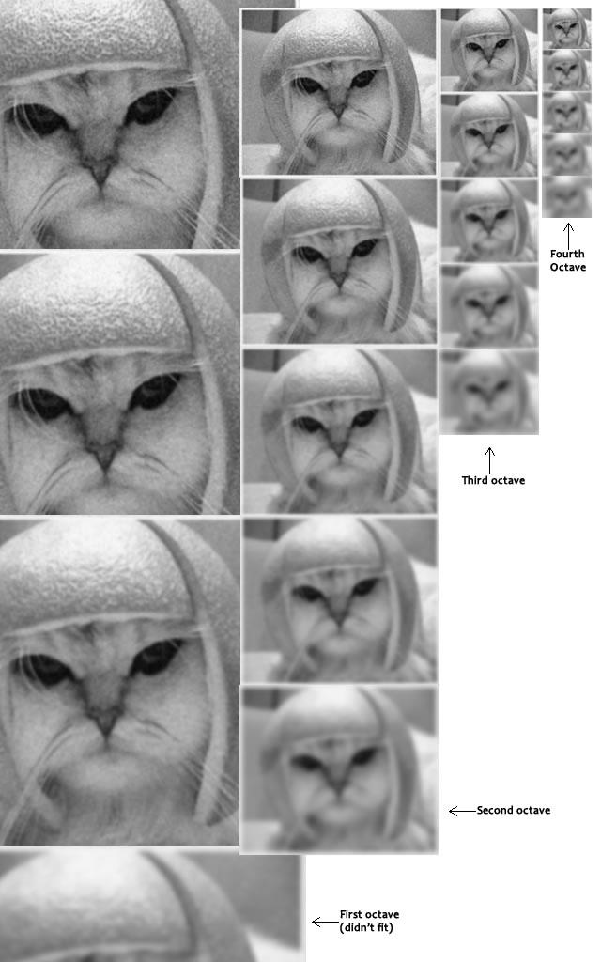
Here different scales of the image is taken.
As the octave changes image is resized to half.
Again different increasing scale of Gaussian blur is applied on the image.
This process continues .
According to lowe’s paper there should be
four octaves and five blur level.
Mathematically, "blurring" is referred to as the convolution of the Gaussian operator and the image which is given by this expression.
L is a blurred image
G is the Gaussian Blur operator
I is an image
x,y are the location coordinates
σ is the "scale" parameter.
The * is the convolution operation in x and y. It "applies" gaussian blur G onto the image I

Slide 9
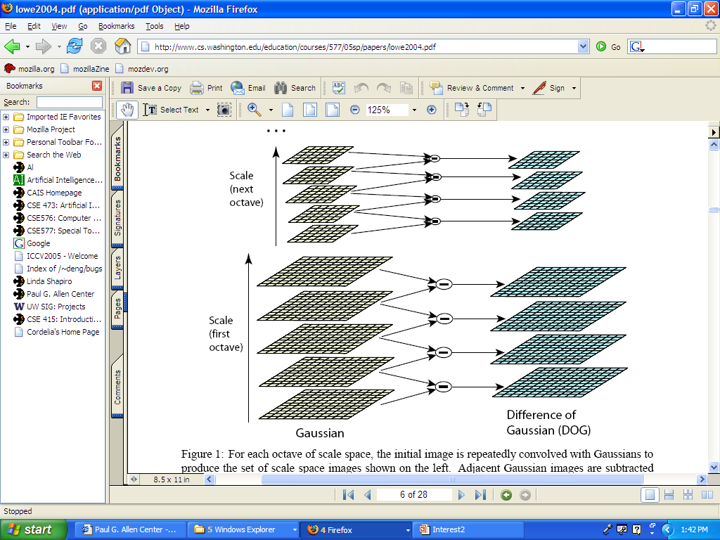
DIFFERENCE OF GAUSSIAN
In this simply , the difference of Gaussian blurred version from another less blurred version is taken.
In this simply the pixel value of two consecutive Gaussian image is subtracted in order to get the difference of Gaussian image (DoG).
The main aim of choosing Gaussian image is that they are rotationally invariant.
In my code I observed that the dog1 and dog4 generally doesn’t show much variation in pixel values . I almost got an array of zero values.
So , It is wise to take dog 2 for further computation.

Slide 10
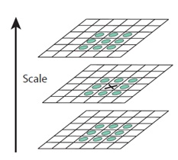
DETECTION OF EXTREMA POINT
In this step we locate the maxima and minima.
We iterate through each pixel and check all it's neighbors. The check is done within the current image, and also the one above and below it.
For each pixel we consider a 3X3 neighborhood in each dog.
For eg: X marks the current pixel. The green circles mark the neighbors. This way, a total of 26 checks are made. X is marked as a "key point" if it is the greatest or least on the basis of pixel values out of all 26 neighbors.

Slide 11
KEY POINT LOCALIZATION
Once a key point candidate is found, a detailed fit to nearby data is performed to determine
location, scale, and ratio of principal curvatures
In initial work key points were found at location and scale of a central sample point.
In newer work, they fit a 3D quadratic function to improve interpolation accuracy.
The Hessian matrix of DoG was used to eliminate edge responses.

Slide 12
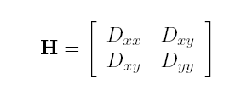


ELIMINATING SOME KEY POINTS
Reject flats:
To discard the low contrast key point, the value of second order taylor expansion of
DoG(x) at extremum is calculated.
If the value is less than 0.03 , then it is discarded
Reject edges:
r < 10
Let α be the eigenvalue with
larger magnitude and β the smaller.
Let r = α/β.
So α = rβ
(r+1)²/r is at a
min when the
2 eigenvalues
are equal.

Slide 13
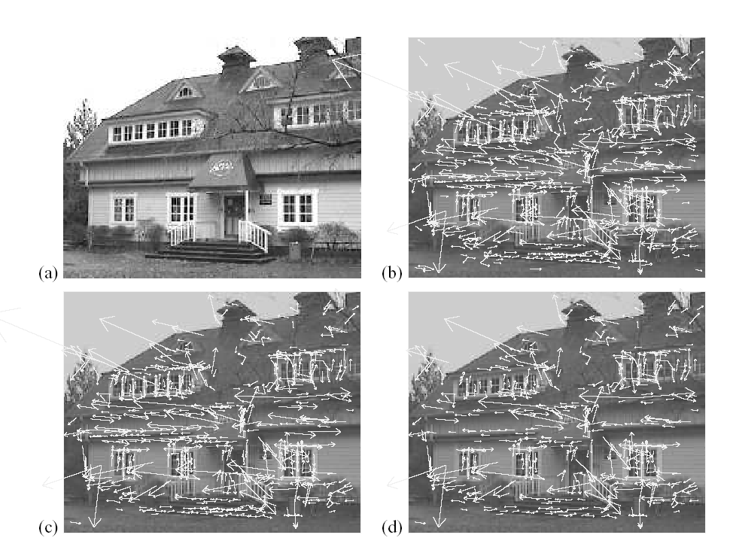
832
233x189
initial keypoints
536
729
Key points after
Discarding low contrast keyponts.
Key points after removal of
Those located on edges.

Slide 14
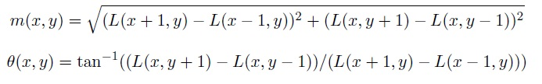
Orientation Assignment
Each key point is assigned one or more orientation based on local image gradient directions.
The magnitude and orientation is assigned around each key point .
Then we figure out which is the peak value and assign that to the key point.
Gradient and magnitudes are found out by this formula :

Slide 15
The magnitude and orientation is calculated for all pixels around the key point. Then, A histogram is created for this.
In this histogram, the 360 degrees of orientation are broken into 36 bins (each 10 degrees.
Once you've done this for all pixels around the key point, the histogram will have a peak at some point.

Slide 16
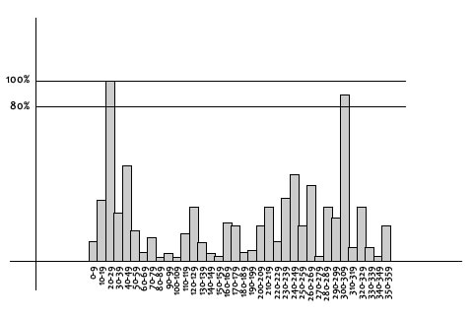
In this , we see the histogram peaks at 20-29 degrees. So, the key point is assigned orientation 3 (the third bin)

Slide 17
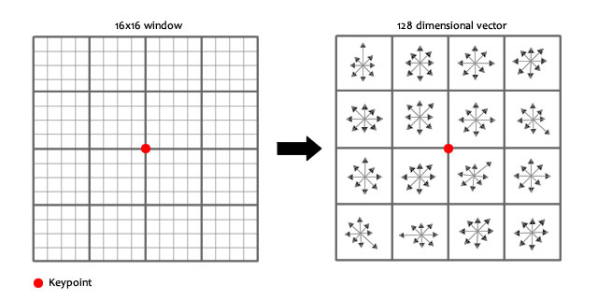
KEYPOINT DESCRIPTOR
Here the idea is to create fingerprint for each key point.
To do this, a 16x16 window around the key point. This 16x16 window is broken into sixteen 4x4 windows.

Slide 18
Within each 4x4 window, gradient magnitudes and orientations are calculated. These orientations are put into an 8 bin histogram.
We end up with a 128 feature vector at the end
We normalize the feature vector.
After getting the normalized feature vector of each point , these can be feed into the neural net.
We can train it
And back propagate in order to reduce the errors.

Slide 19
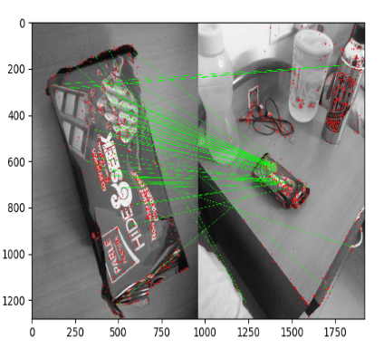
CONCLUSION
In case of object recognition feature matching was done. Out of 548 feature points, 360 were matched properly. It showed an error of 34 % (approx.) (Green ones show the feature matching and red ones show the unmatched features)

Slide 20
REFERENCES
1. Lowe, D.G., 2004. Distinctive image features from scale-invariant keypoints. International journal of computer vision, 60(2), pp.91-110.
2. Mark, N. and Alberto, S.A., 2008. Feature extraction and image processing. Nixon, Mark S. Amsterdam.
3. Davidson, W. and Abramowitz, M., 2006. Molecular expressions microscopy primer: Digital image processing-difference of gaussians edge enhancement algorithm. Olympus America Inc., and Florida State University.
4. Lindeberg, T., 1993. Detecting salient blob-like image structures and their scales with a scale-space primal sketch: A method for focus-of-attention. International Journal of Computer Vision, 11(3), pp.283-318
5. Mikolajczyk, K. and Schmid, C., 2004. Scale & affine invariant interest point detectors. International journal of computer vision, 60(1), pp.63-86.
6. Brown, M. and Lowe, D.G., 2002, September. Invariant Features from Interest Point Groups. In BMVC (Vol. 4).
7. Harris, C. and Stephens, M., 1988, August. A combined corner and edge detector. In Alvey vision conference (Vol. 15, No. 50, pp. 10-5244).
8. L. G. Shapiro & G. C. Stockman, “Computer Vision”, page 137~150. Prentice Hall, (2001).
9. Wagner, D., Reitmayr, G., Mulloni, A., Drummond, T. and Schmalstieg, D., 2008, September. Pose tracking from natural features on mobile phones. In Proceedings of the 7th IEEE/ACM International Symposium on Mixed and Augmented Reality (pp. 125-134). IEEE Computer Society.
10. Lowe, D.G., 1999. Object recognition from local scale-invariant features. In Computer vision, 1999. The proceedings of the seventh IEEE international conference on (Vol. 2, pp. 1150-1157).
11. Toews, M., Wells, W., Collins, D.L. and Arbel, T., 2010. Feature-based morphometry: Discovering group-related anatomical patterns. NeuroImage, 49(3), pp.2318-2327.
12. Cui, Y., Hasler, N., Thormählen, T. and Seidel, H.P., 2009, July. Scale invariant feature transform with irregular orientation histogram binning. In International Conference Image Analysis and Recognition (pp. 258-267). Springer, Berlin, Heidelberg.

Slide 21
THANK YOU

